Slide 1

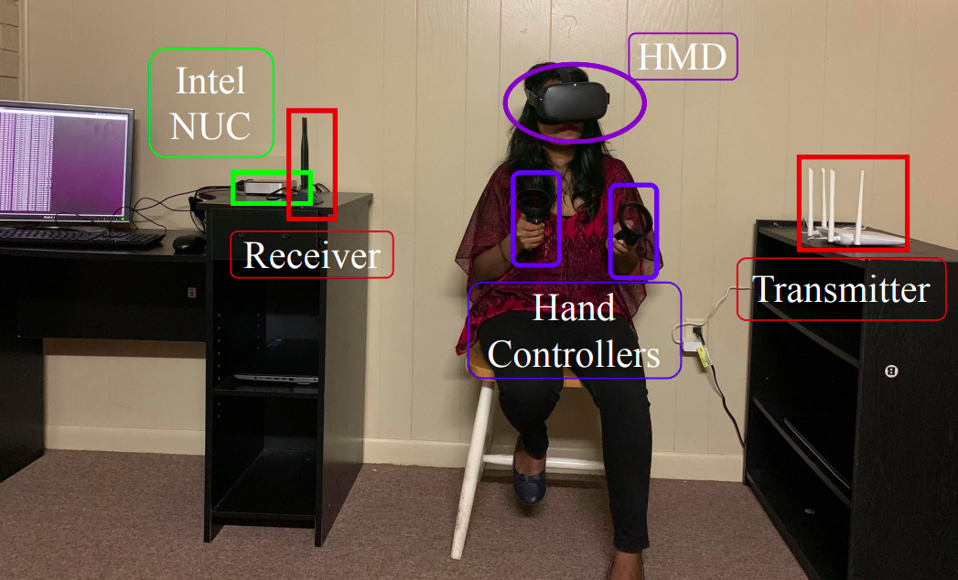
“VR-Spy: A Side-Channel Attack on Virtual Key-Logging in VR Headsets”
2021 IEEE Virtual Reality and 3D User Interfaces (VR), 2021, pp. 564 - 572
Lisbon, Portugal | 27th March - 1st April 2021
Abdullah Al Arafat, Zhishan Guo and Amro Awad
IHC - Paper Presentation
André Clérigo, 98485
Pedro Rocha, 98256

Slide 2
Index
01 Introduction
03
Paper Analysis
05 Discussion
02
Motivation
04 Related Work
06 Conclusion

Slide 3
Section 01.
Introduction

Slide 4
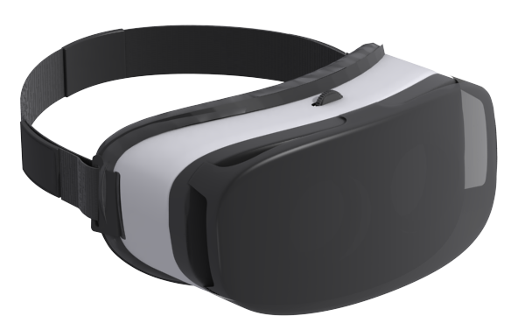
Introduction
Virtual reality technology is experiencing rapid growth.
VR was mainly used for playing video games but now new applications have emerged.
These new applications involve lots of confidential information. Users can surf web-pages, access private accounts or bank account information.
1
Can you trust VR devices to access sensitive information?
Notes:
Other areas: military use, surfing web pages, access to private/bank accounts, online shopping

Slide 5
Section 02.
Motivation

Slide 6
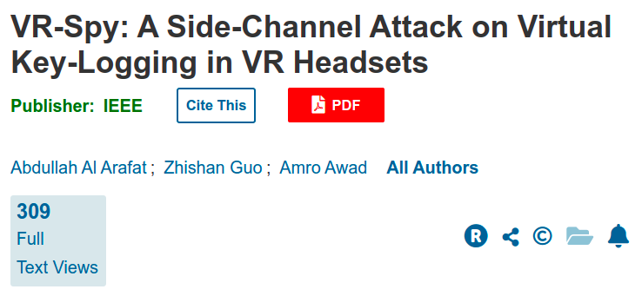
Motivation
Why did we choose VR-Spy?
Fast growing technology
Interesting subject
Big security concerns
1
https://ieeexplore.ieee.org/document/9417659

Slide 7
Section 03.
Paper Analysis

Slide 8
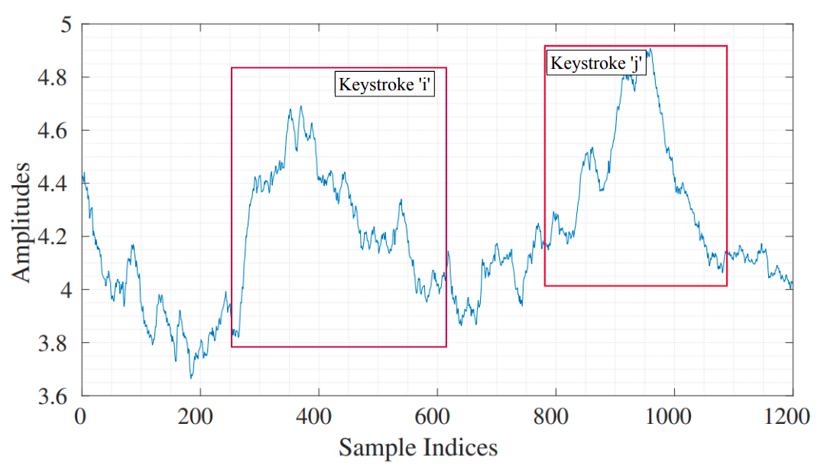
Introduction
01
VR-Spy, a virtual keystrokes recognition method using channel state information (CSI) of WiFi signals.
Using two Commercially Off-The-Shelf (COTS) devices, VR-Spy achieves 69% in virtual keystrokes recognition.
Keystroke recognition using CSI
Notes:
Power consumption, frequency spectrum, current/voltage consumptions, etc
Ataque direcionados a sistemas VR
channel state information (CSI)

Slide 9
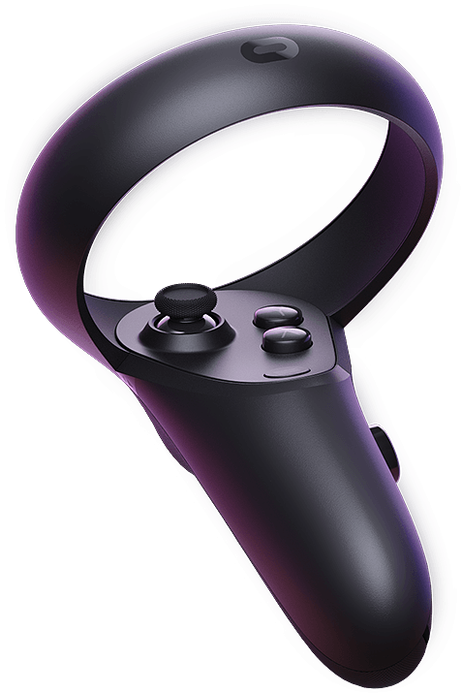
Assumptions
02
A WiFi communication link available in the victim’s place, and the attacker can access it
The attacker knows the virtual keyboard layout (typically public information)
The hand controllers of VR have either a touchpad or buttons

Slide 10
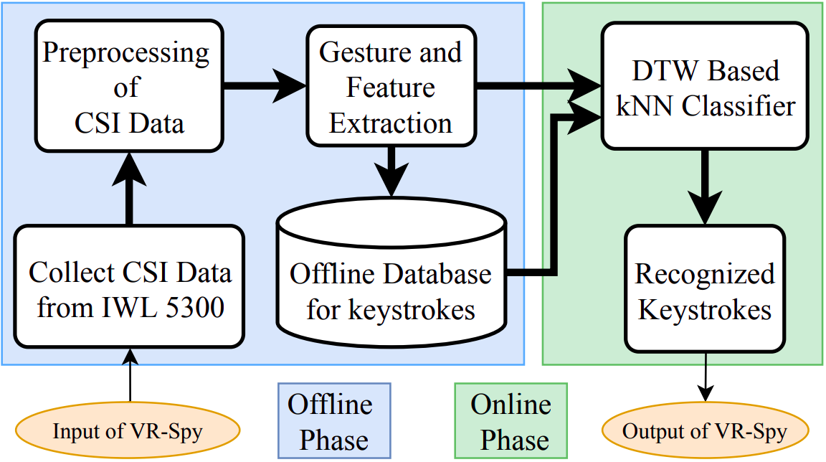
How does it work?
03
The VR-Spy consists of three parts
CSI data acquisition from target gestures for virtual keystrokes in offline (adding preprocessing to remove outliers)
Gesture extraction for each virtual keystroke using an algorithm
Recognize each gesture to a specific keystroke using a classifier
VR Spy Framework

Slide 11
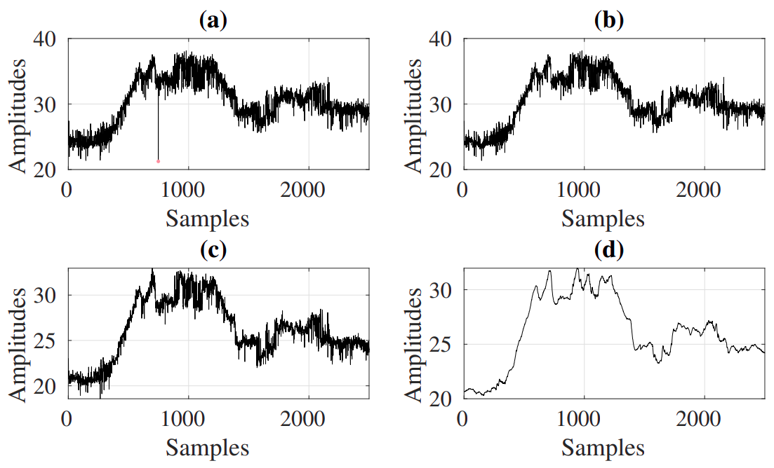
How does it work?
03
In Preprocessing of CSI Stream:
Outliers Removal
Low-Pass Filter
Weighted Moving Average
In Virtual Keystrokes Extraction:
PCA of Normalized CSI Stream
Detection of Terminal Points
Gesture & Feature Extraction
In Classification:
Dynamic time warping
Preprocessed CSI stream
Notes:
Outliers filter - Hampel outliers’ identifier
Low pass filter - Undesired CSI stream lies in the high end of the frequency spectrum
Weighted Moving Average - A smoothing filter
PCA Normalized - CSI stream has 30 sub-carriers and this is computational intensive so they mapped the data into a lower dimension space
Terminal Points - Found out the peaks in the waveform generated and choose an empirical threshold of 0.05
Dynamic time warping - Dynamic time warping can measure the distance between two waveforms
Preprocessed CSI stream: (a) A raw CSI stream, (b) CSI stream after removing the outliers, (c) CSI stream after applying low-pass filter, and (d) CSI stream after applying the weighted average filter

Slide 12
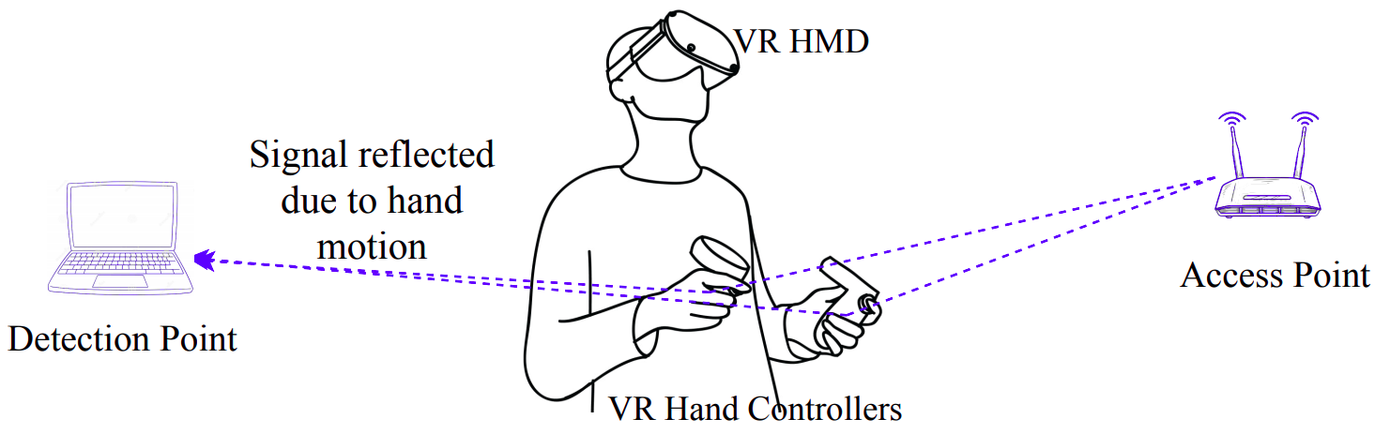
Implementation
04
Experiment Setup
WiFi 5G
Oculus Quest
Virtual Keyboard
Data Collection
Notes:
Wifi 5G - In the experiment, was used 5G instead of the 2.4G to avoid interference from other ISM band communication links such as Bluetooth communication. Oculus Quest has a Head Mounted Display and two hand controllers
Data Collection - The voluntary participant’s ages range from 25 years to 32 years, including variant sex, heights, weights, and race.

Slide 13
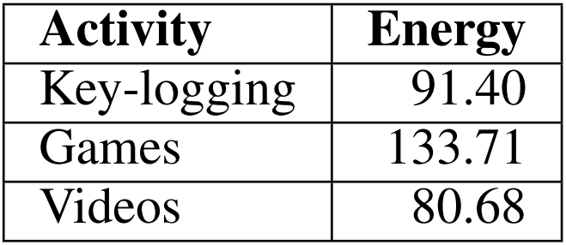
Results
05
Activity Detection
Firstly, we need to detect whether the user is writing something or not.
Games
Videos
Key-logging
Notes:
Dataset for evaluation of VRSpy consists of ten different users’ data samples.
Possivel dividir em mais atividades, mas resumiu-se a 3
Firstly we need to detect whether the user is writing something or not. Games and key logging têm densidade de ondas de movimento (mais energeticas) num dado periodo de tempo, no entanto distinguem se claramente na quantidade de energia produzida pela o user.

Slide 14
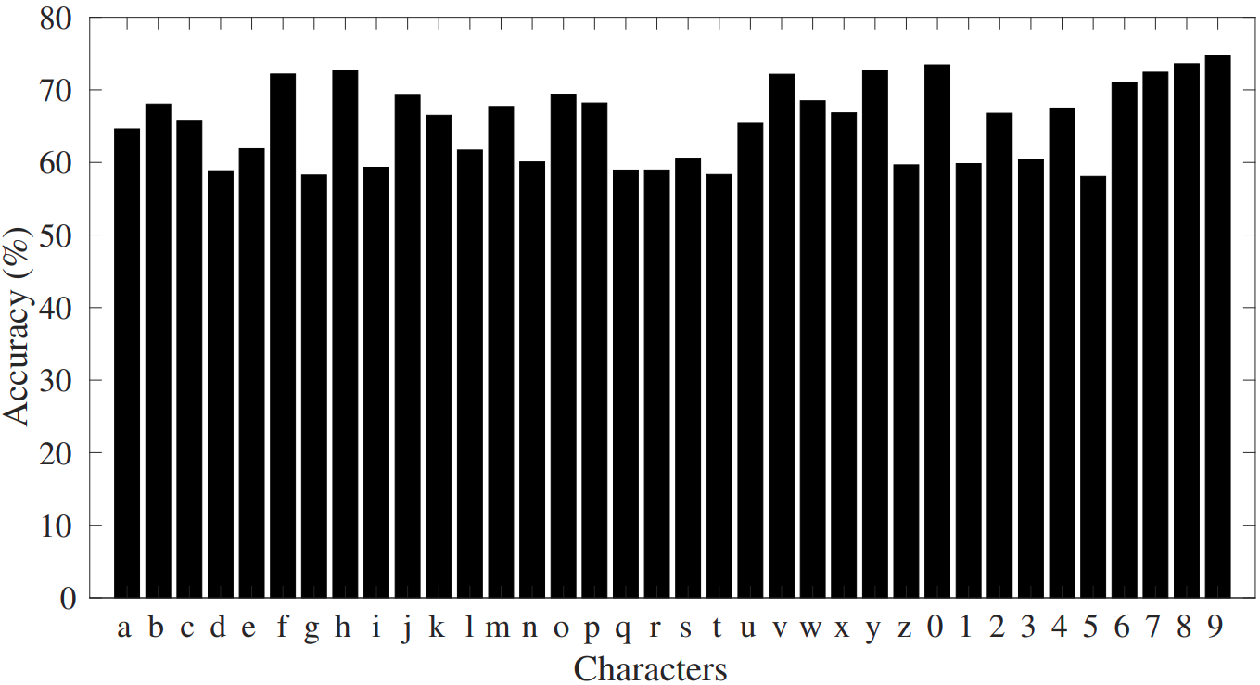
Results
05
Individual Keystroke Recognition Accuracy
The minimum accuracy is 59.8% for ’5’, and the maximum accuracy is 76.18% for ’9’.
The average accuracy of the keystrokes is 69.75%.
The accuracy is reasonable when compared with sensors-based keystroke recognition methods.
Notes:
Considerando que estamos num registo de chave detetado
Precisamos de identificar qual é efetivamente a tecla a ser pressionada e após o treino de perceção da atividade, juntamos os datasets todos para detetar que carater é selecionado, conseguindo assim algumas percentagens. Esta percentagem é obtida atraves da comparaçao com metodos de reconhecimento de pressionamento de uma tecla baseada em sensores de visão e movimento

Slide 15
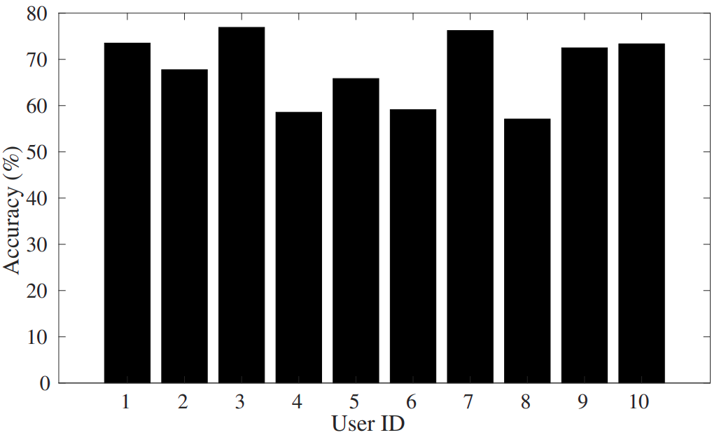
Results
05
Individual User’s Accuracy
To evaluate the robustness, 10 different users were used.
The performance differs for the different users as the gesture patterns are often varied and unique.
The variance of the accuracy among the users is 19.17%.

Slide 16
Related Work
In VR attacks:
OcuLock: Exploring Human Visual System for Authentication in Virtual Reality HMD, Luo et al - Proposes a novel biometric authentication system for VR HMD
I Know What You Enter on Gear VR, Ling et al - Uses a stereo camera to record the VR user’s headset and controller touchpad motions
In Gesture computing using WiFi:
Writing in the Air with WiFi Signals for Virtual Reality Devices, Fu et al - Developed an air handwriting recognition for VR devices
Notes:
I Know What You Enter On Gear VR - Utiliza malware e cameras o que é menos acessivel

Slide 17
Section 05.
Discussion

Slide 18
Discussion
There are some limitations to point out
Keyboard Layout - The gestures are related to the virtual keyboard layout. It is possible to change the keyboard layout, and in those cases, VR-Spy cannot be implemented
Antennas - The signal strength inversely depends on the distance between antennas, which affects the performance. In this case 1.27m was used
Dataset - A dataset with large samples increases the accuracy of the model. In VR-Spy, 30 samples were used per character
Notes:
VR-Spy is easily adaptable to any virtual keystrokes recognition, including AR devices.

Slide 19
Section 06.
Conclusions

Slide 20
Conclusion
In this paper, a novel side channel attack was introduced, this attack was aimed to VR devices to infer the text inputs through a gesture detection algorithm and variations of the CSI stream.
VR-Spy uses two commercially antenna devices, 1.27m apart to build a communication with the victim placed in between of them.
An average virtual keystrokes recognition accuracy of 69.75% was obtained.
In future work, researchers will consider a more relax model allowing moving objects with the victim and will investigate the attack with unknown layouts.

Slide 21
Questions?

Slide 22
References
A. A. Arafat, Z. Guo and A. Awad, "VR-Spy: A Side-Channel Attack on Virtual Key-Logging in VR Headsets," 2021 IEEE Virtual Reality and 3D User Interfaces (VR), 2021, pp. 564-572, doi: 10.1109/VR50410.2021.00081
S. Luo, A. Nguyen, C. Song, F. Lin, W. Xu, and Z. Yan. Oculock: Exploring human visual system for authentication in virtual reality head-mounted display. NDSS, 2020.
Z. Fu, J. Xu, Z. Zhu, A. X. Liu, and X. Sun. Writing in the air with wifi signals for virtual reality devices. IEEE Transactions on Mobile Computing, 18(2):473–484, 2019
Z. Ling, Z. Li, C. Chen, J. Luo, W. Yu, and X. Fu. I know what you enter on gear vr. In 2019 IEEE Conference on Communications and Network Security (CNS), pp. 241–249, June 2019. doi: 10.1109/CNS. 2019.8802674

